Slide 1
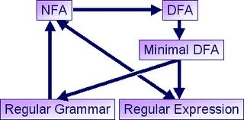
Regular Expressions
Course Instructor: Mr. Hashim Ayub

Slide 2
NFA RE Equivalence
YouTube Lectures (Channel: Tayyaba Zaheer)
(TheAutoForm-GTG AND NfaReEquivalence) https://www.youtube.com/watch?v=pT_aLK-gLeY

Slide 3

Regular Expression = R.E = bca*bc $\sum{=\{a,b,c\}}$
NFA
TG
GTG
a
b
c
b
c
1
2
3
4
5
a
bc
bc
1
3
5
bca*bc
1
5

Slide 4






$$M$$
From construct the equivalent
Generalized Transition Graph
in which transition labels are regular expressions
Example:
Corresponding
Generalized transition graph
$$M$$
$$a$$
$$c$$
$$a$$
$$c$$
$$a,b$$
$$a+b$$

Slide 5
State Removal Method
The key idea
The idea is to consider regular expressions on edges and then removing intermediate states while keeping the edges labels consistent.

Slide 6
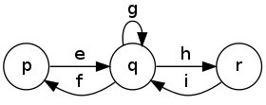
State Removal Method
The key idea
The main pattern can be seen in the following two figures. The first has labels between p,q,r that are regular expressions e,f,g,h,i and we want to remove q.

Slide 7
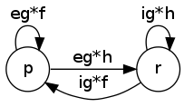
State Removal Method
The key idea
Once removed, we compose e,f,g,h,i together (while preserving the other edges between p and r but this is not displayed on this):

Slide 8
Example 1
From NFA to regex in 8 easy figures

Slide 9
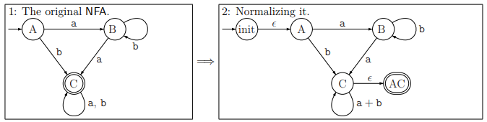

Slide 10
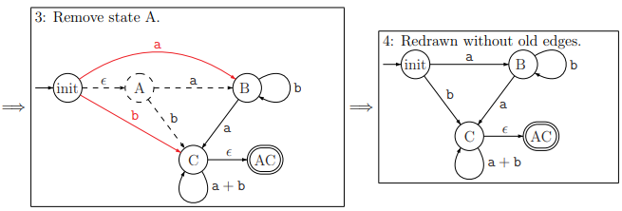

Slide 11
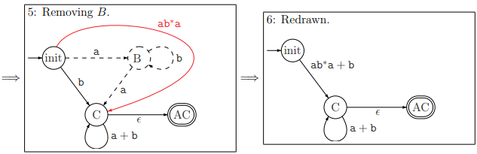

Slide 12
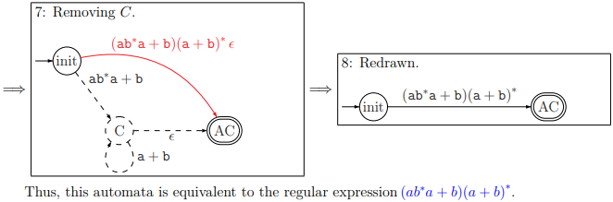

Slide 13
Example 2

Slide 14




$$NFA$$
b
a
b
a
1
2
$$∈$$
S
1
2
a
b
a
a
b
b
a
3
b
$$∈$$
3
$$∈$$
r

Slide 15


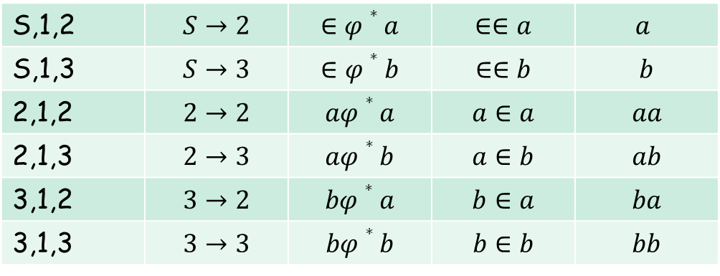



b
b
a
a
$$∈$$
S
1
2
S
2
a
a
b
b
a
a
b
$$∈$$
b
$$∈$$
3
3
$$∈$$
$$∈$$
r
r
S,1,2 | $$S→2$$ | $$∈φ∗a$$ | $$∈∈a$$ | $$a$$
S,1,3 | $$S→3$$ | $$∈φ∗b$$ | $$∈∈b$$ | $$b$$
2,1,2 | $$2→2$$ | $$aφ∗a$$ | $$a∈a$$ | $$aa$$
2,1,3 | $$2→3$$ | $$aφ∗b$$ | $$a∈b$$ | $$ab$$
3,1,2 | $$3→2$$ | $$bφ∗a$$ | $$b∈a$$ | $$ba$$
3,1,3 | $$3→3$$ | $$bφ∗b$$ | $$b∈b$$ | $$bb$$

Slide 16



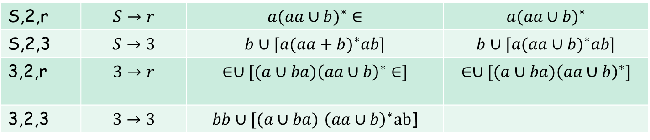



b
a
$${a(aa∪b)}^{∗}$$
S
r
S
2
a
$$b∪[{a(aa∪b)}^{∗}ab]$$
b
$$∈∪[(a∪ba){\left(aa∪b\right)}^{∗}]$$
a
b
$$∈$$
3
3
$$∈$$
$$bb∪[(a∪ba) {\left(aa∪b\right)}^{∗}ab\text{]}$$
r
S,2,r | $$S→r$$ | $${a(aa∪b)}^{∗}∈$$ | $${a(aa∪b)}^{∗}$$
S,2,3 | $$S→3$$ | $$b∪[{a(aa+b)}^{∗}ab]$$ | $$b∪[{a(aa∪b)}^{∗}ab]$$
3,2,r | $$3→r$$ | $$∈∪[(a∪ba){\left(aa∪b\right)}^{∗}∈]$$ | $$∈∪[(a∪ba){\left(aa∪b\right)}^{∗}]$$
3,2,3 | $$3→3$$ | $bb∪[(a∪ba)$ ${\left(aa∪b\right)}^{∗}ab$]

Slide 17




$${a(aa∪b)}^{∗}$$
S
r
$$b∪[{a(aa∪b)}^{∗}ab]$$
$$∈∪[(a∪ba){\left(aa∪b\right)}^{∗}]$$
3
$$bb∪[(a∪ba) {\left(aa∪b\right)}^{∗}ab\text{]}$$
$${a(aa∪b)}^{∗}∪[\left(b∪\left[{a\left(aa∪b\right)}^{∗}ab\right]\right){(bb∪[(a∪ba) {\left(aa∪b\right)}^{∗}ab\text{] })}^{∗}\left(∈∪\left[\left(a∪ba\right){\left(aa∪b\right)}^{∗}\right]\right)]$$
S
r
S,3,r | $$S→r$$ | $${a(aa∪b)}^{∗}∪[\left(b∪\left[{a\left(aa∪b\right)}^{∗}ab\right]\right){(bb∪[(a∪ba) {\left(aa∪b\right)}^{∗}ab\text{] })}^{∗}\left(∈∪\left[\left(a∪ba\right){\left(aa∪b\right)}^{∗}\right]\right)]$$

Slide 18





Proof - Part 2
Languages
Generated by
Regular Expressions
Regular
Languages
$$⊇$$
For any regular language there is
a regular expression with
$$L$$
$$L(r)=L$$
$$r$$
We will convert an NFA that accepts
to a regular expression
$$L$$

Slide 19



Since is regular, there is a
NFA that accepts it
$$L$$
$$M$$
$$L(M)=L$$
Take it with a single accept state

Slide 20

From construct the equivalent
Generalized Transition Graph
in which transition labels are regular expressions
$$M$$
Example:
Corresponding
Generalized transition graph
$$M$$
$$a$$
$$c$$
$$a$$
$$c$$
$$a,b$$
$$a+b$$

Slide 21










$$b$$
$$b$$
Another Example:
$$a$$
$$q_{0}$$
$$q_{1}$$
$$a,b$$
$$q_{2}$$
$$b$$
Transition labels
are regular
expressions
$$b$$
$$b$$
$$a$$
$$q_{0}$$
$$q_{1}$$
$$a+b$$
$$q_{2}$$
$$b$$

Slide 22










$$b$$
$$b$$
Reducing the states:
$$a$$
$$q_{0}$$
$$q_{1}$$
$$a+b$$
$$q_{2}$$
$$b$$
Transition labels
are regular
expressions
$$bb∗a$$
$$b$$
$$bb∗(a+b)$$
$$q_{0}$$
$$q_{2}$$

Slide 23


Resulting Regular Expression:
$$bb∗a$$
$$b$$
$$bb∗(a+b)$$
$$q_{0}$$
$$q_{2}$$
$$r=(bb∗a)∗⋅bb∗(a+b)⋅b∗$$
$$L(r)=L(M)=L$$

Slide 24











In General
Removing a state:
$$e$$
$$d$$
$$c$$
$$q_{i}$$
$$q_{j}$$
$$q$$
$$a$$
$$b$$
$$ae∗d$$
$$ce∗b$$
$$ce∗d$$
$$q_{i}$$
$$q_{j}$$
$$ae∗b$$

Slide 25








By repeating the process until
two states are left, the resulting graph is
Initial graph
Resulting graph
$$r_{1}$$
$$r_{4}$$
$$r_{3}$$
$$q_{0}$$
$$q_{f}$$
$$r_{2}$$
The resulting regular expression:
$$r=r_{1}∗r_{2}(r_{4}+r_{3}r_{1}∗r_{2})∗$$
$$L(r)=L(M)=L$$
End of Proof-Part 2

Slide 26
Summary: Standard Representations of Regular Languages
Regular Languages
DFAs
Regular
Expressions
NFAs

Slide 27
Questions?
Thank You!

